Slide 1


Lec14 实验五 用户进程管理
清华大学计算机系

Slide 2

概 述
■
总体介绍
■
进程的内存布局
■
执行ELF格式的二进制代码
■
进程复制
■
内存管理的copy-on-write机制

Slide 3
总体介绍
■
目标
■
练习
hello
■
流程概述
user
space
do_execve(“hello”)
kernel
space
idle
init
initial
instruction
flow
init_main()
user_main()

Slide 4
总体介绍
■
目标
■
了解第一个用户进程创建过程
■
了解进程管理的实现机制
■
了解系统调用框架的实现机制

Slide 5
总体介绍
■
练习
■
加载应用程序并执行
■
父进程复制自己的内存空间给子进程
■
分析系统调用和进程管理的实现

Slide 6
总体介绍
■
流程概述
hello应用程序
#include <stdio.h>
#include <ulib.h>
int main(void) {
cprintf("Hello world!!.\n");
cprintf("I am process %d.\n", getpid());
cprintf("hello pass.\n");
return 0;
}

Slide 7
总体介绍
■
流程概述
■
给应用程序需要一个用户态运行环境
进程管理
内存管理
加载，复制，生命周期，系统调用
用户态虚拟内存

Slide 8
总体介绍
■
流程概述
■
“硬”构造出第一个用户进程
建立用户代码/数据段
创建内核线程
创建用户进程“壳”
执行用户进程
填写用户进程“肉”
完成系统调用
结束用户进程

Slide 9
■
理解如何如何配置和建立用户空间
进程的内存布局

Slide 10
4G
Empty Memory(*)
内核虚拟内存布局
0xFB000000
Cur.Page Table (Kern,RW)
RW/-- PTSIZE
VPT
0xFAC00000
Invalid Memory (*)
--/--
KERNTOP
0xF8000000
Remapped Physical Memory
RW/-- KMEMSIZE
KERNBASE
0xC0000000
Invalid Memory (*)
--/--
USERTOP
0xB0000000
User stack
User Proqram & Heap
UTEXT
0x00800000
Invalid Memory (*)
--/--
User STAB Data (optional)
USERBASE,USTAB
0x00200000
Invalid Memory (*)
--/--
0
0x00000000

Slide 11
4G
Empty Memory(*)
内核虚拟内存布局
0xFB000000
Cur.Page Table (Kern,RW)
RW/-- PTSIZE
VPT
0xFAC00000
Invalid Memory (*)
--/--
KERNTOP
0xF8000000
Remapped Physical Memory
RW/-- KMEMSIZE
KERNBASE
0xC0000000
Invalid Memory (*)
--/--
USERTOP
0xB0000000
User stack
进程虚拟内存布局
User Proqram & Heap
UTEXT
0x00800000
Invalid Memory (*)
--/--
User STAB Data (optional)
USERBASE,USTAB
0x00200000
Invalid Memory (*)
--/--
0
0x00000000

Slide 12
4G
Empty Memory(*)
内核虚拟内存布局
0xFB000000
Cur.Page Table (Kern,RW)
RW/-- PTSIZE
VPT
0xFAC00000
Invalid Memory (*)
--/--
KERNTOP
0xF8000000
Remapped Physical Memory
RW/-- KMEMSIZE
KERNBASE
0xC0000000
Invalid Memory (*)
--/--
USERTOP
0xB0000000
User stack
进程虚拟内存布局
User Proqram & Heap
UTEXT
0x00800000
Invalid Memory (*)
--/--
User STAB Data (optional)
USERBASE,USTAB
0x00200000
Invalid Memory (*)
--/--
0
0x00000000

Slide 13
■
理解如何加载ELF格式的二进制代码到用户空间并运行
执行ELF格式的二进制代码

Slide 14
■
简要描述
执行ELF格式的二进制代码

Slide 15
执行ELF格式的二进制代码-简要描述
CPU
Memory
File System
Storage
program B

Slide 16
执行ELF格式的二进制代码-简要描述
CPU
Memory
program B

Slide 17
执行ELF格式的二进制代码-简要描述
用户进程
用户进程的“壳”
int 0x80
Process
pid = X
Process pid = X
do_execve
CPU
Memory
ucore
program B
program B

Slide 18
进程控制块
PCB

Slide 19
进程控制块
int pid
PCB
char[15+1] name
enum proc_state state
int runs
volatile bool need_resched
uint32_t flags
uintptr_t kstack
struct proc_struct
uintptr_t cr3
struct mm_struct * mm
struct context context
struct trapframe *tf
struct proc_struct *parent
list_entry_t list_link
list_entry_t hash_link

Slide 20
■
do_execve的实现
执行ELF格式的二进制代码

Slide 21
执行ELF格式的二进制代码 – 步骤 (do_execve)
delete old memory space
do_execve:: proc.c
if (mm != NULL) {
lcr3(boot_cr3);
if (mm_count_dec(mm) == 0) {
exit_mmap(mm);
put_pgdir(mm);
mm_destroy(mm);
}
current->mm = NULL;
}
Process
pid = X

Slide 22
执行ELF格式的二进制代码 – 步骤 (do_execve)
delete old memory space
do_execve::proc.c
call load_icode()
do_execve:: proc.c
if ((ret = load_icode(binary, size)) != 0) {
goto execve_exit;
}

Slide 23
执行ELF格式的二进制代码 – 步骤 (do_execve)
delete old memory space
do_execve:: proc.c
call load_icode()
do_execve:: proc.c
return 0
do_execve:: proc.c

Slide 24
■
load_icode的实现
执行ELF格式的二进制代码

Slide 25
■
ELF File
relocatable file
executable file
shared object file
Notes:
Sections hold the bulk of object file information for the linking view: instructions, data, symbol table, relocation information, and so on.

Slide 26
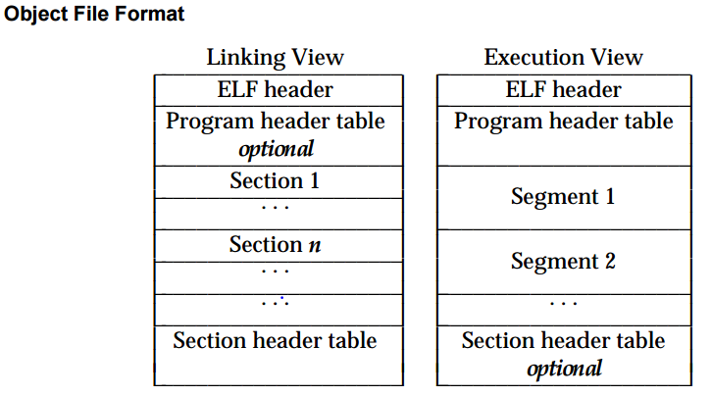
■
ELF File
relocatable file
executable file
shared object file
Notes:
Sections hold the bulk of object file information for the linking view: instructions, data, symbol table, relocation information, and so on.

Slide 27
■
ELF File
relocatable file
executable file
shared object file
Notes:
Sections hold the bulk of object file information for the linking view: instructions, data, symbol table, relocation information, and so on.

Slide 28
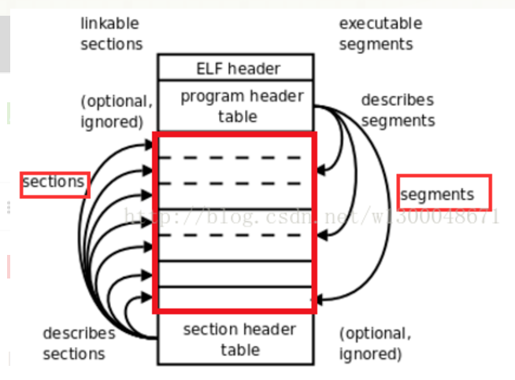
■
ELF File
relocatable file
executable file
shared object file
Notes:
Sections hold the bulk of object file information for the linking view: instructions, data, symbol table, relocation information, and so on.

Slide 29
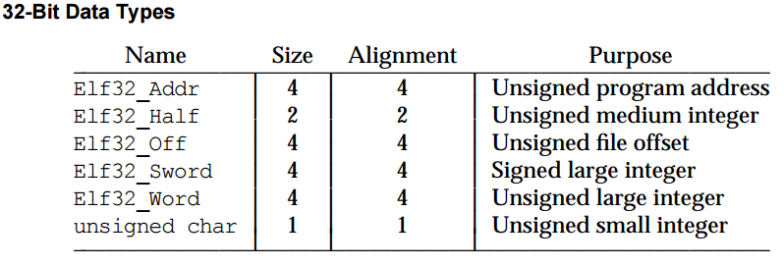
■
ELF File
relocatable file
executable file
shared object file
Notes:
Sections hold the bulk of object file information for the linking view: instructions, data, symbol table, relocation information, and so on.

Slide 30
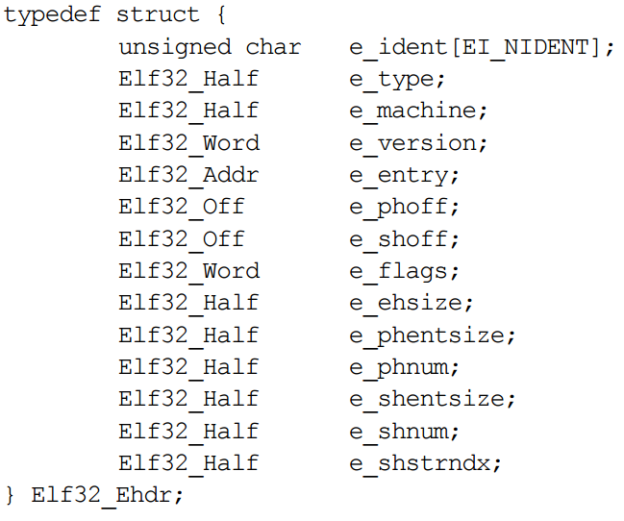
■
ELF File
relocatable file
executable file
shared object file
Notes:
Sections hold the bulk of object file information for the linking view: instructions, data, symbol table, relocation information, and so on.

Slide 31
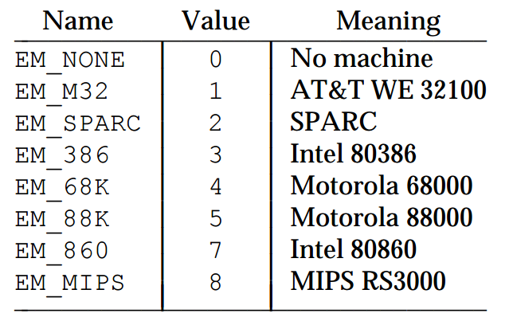
■
ELF File
relocatable file
executable file
shared object file
Notes:
Sections hold the bulk of object file information for the linking view: instructions, data, symbol table, relocation information, and so on.

Slide 32
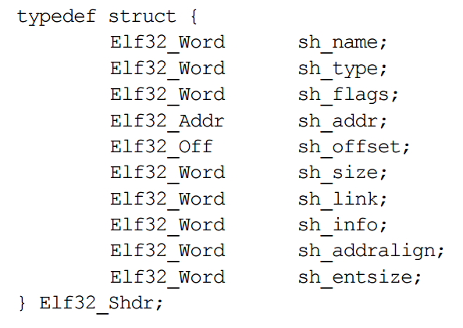
Section Header
■
ELF File
relocatable file
executable file
shared object file
Notes:
Sections hold the bulk of object file information for the linking view: instructions, data, symbol table, relocation information, and so on.

Slide 33
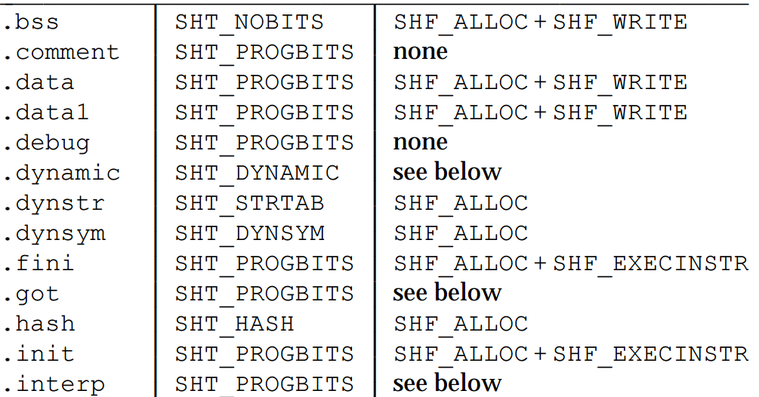
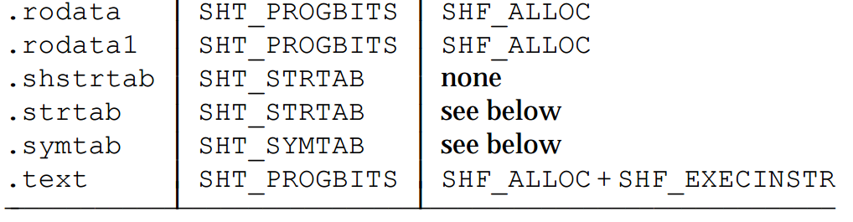
Section Header
■
ELF File
Notes:
Sections hold the bulk of object file information for the linking view: instructions, data, symbol table, relocation information, and so on.

Slide 34
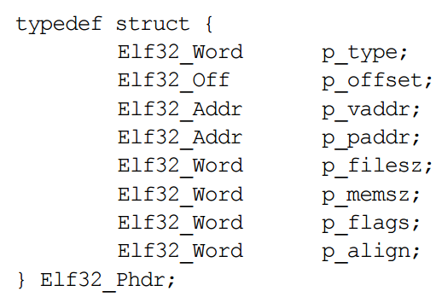
Program Header
■
ELF File
relocatable file
executable file
shared object file
Notes:
Sections hold the bulk of object file information for the linking view: instructions, data, symbol table, relocation information, and so on.

Slide 35
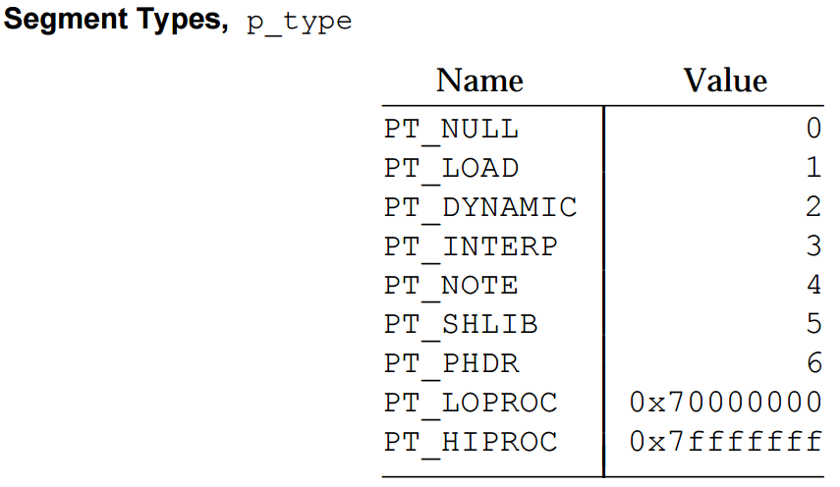
■
ELF File
relocatable file
executable file
shared object file
Notes:
Sections hold the bulk of object file information for the linking view: instructions, data, symbol table, relocation information, and so on.

Slide 36
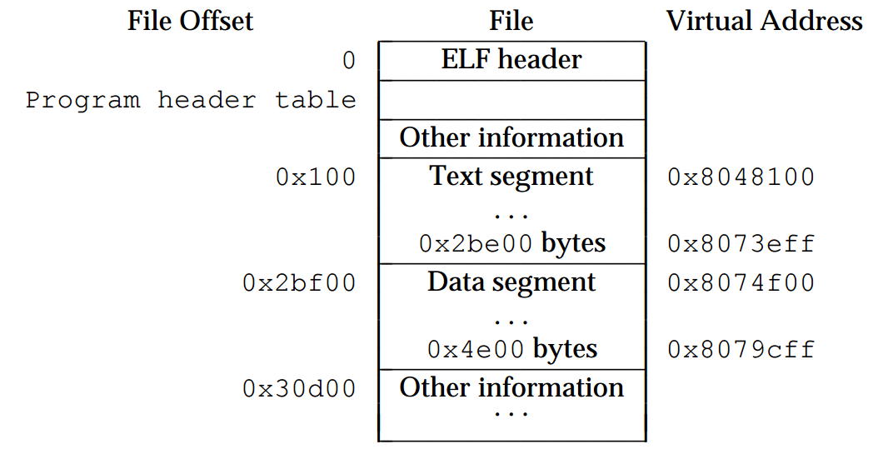
■
executable file
ELF File
Notes:
Sections hold the bulk of object file information for the linking view: instructions, data, symbol table, relocation information, and so on.

Slide 37
■
executable file
ELF File
Notes:
Sections hold the bulk of object file information for the linking view: instructions, data, symbol table, relocation information, and so on.

Slide 38
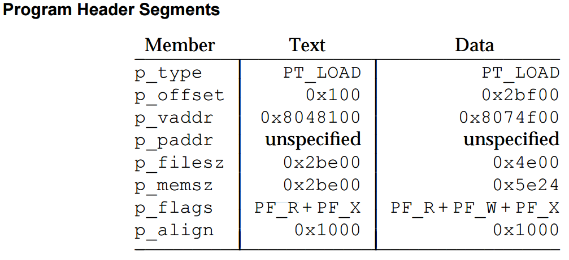
■
executable file
ELF File
Notes:
Sections hold the bulk of object file information for the linking view: instructions, data, symbol table, relocation information, and so on.

Slide 39
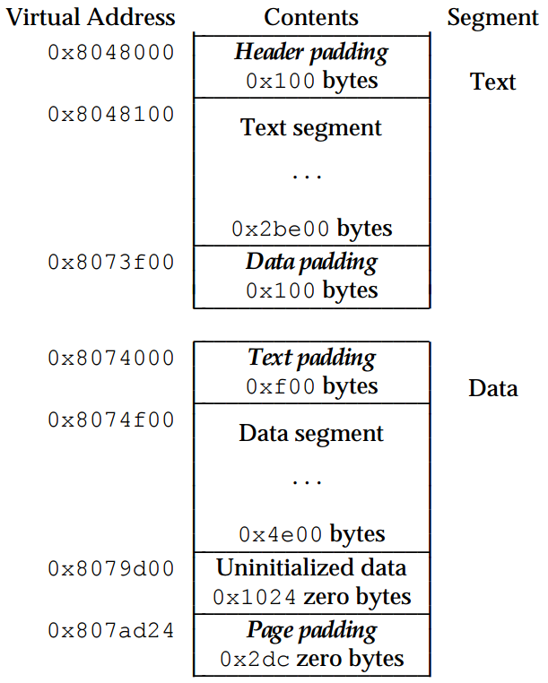
■
ELF File
executable file
Notes:
Sections hold the bulk of object file information for the linking view: instructions, data, symbol table, relocation information, and so on.

Slide 40
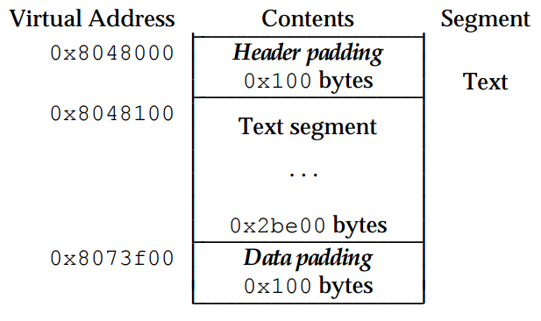
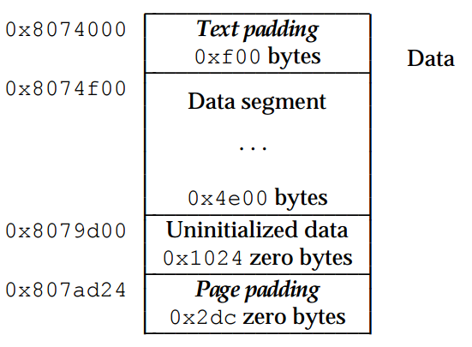
■
ELF File
executable file
Notes:
Sections hold the bulk of object file information for the linking view: instructions, data, symbol table, relocation information, and so on.

Slide 41
执行ELF格式的二进制代码 – 步骤 (load_icode)
create new memory space
load_icode::proc.c
if ((mm = mm_create()) == NULL) {
goto bad_mm;
}
if (setup_pgdir(mm) != 0) {
goto bad_pgdir_cleanup_mm;
}
Process pid = X

Slide 42
执行ELF格式的二进制代码 – 步骤 (load_icode)
create new memory space
load_icode::proc.c
for each section in ELF: …
load_icode::proc.c
struct elfhdr *elf = (struct elfhdr *)binary;
struct proghdr *ph =
(struct proghdr *)(binary + elf->e_phoff);
……
}
struct proghdr *ph_end = ph + elf->e_phnum;
for (; ph < ph_end; ph ++) {
……
}

Slide 43
执行ELF格式的二进制代码 – 步骤 (load_icode)
create new memory space
load_icode::proc.c
for each section in ELF: …
load_icode::proc.c
setup VMA
mm_map::vmm.c
vm_flags = 0, perm = PTE_U;
if (ph->p_flags & ELF_PF_X) vm_flags |= VM_EXEC;
if (ph->p_flags & ELF_PF_W) vm_flags |= VM_WRITE;
if (ph->p_flags & ELF_PF_R) vm_flags |= VM_READ;
if (vm_flags & VM_WRITE) perm |= PTE_W;
if ((ret = mm_map(mm, ph->p_va, ph->p_memsz, vm_flags, NULL)) != 0) {
goto bad_cleanup_mmap;
}

Slide 44
执行ELF格式的二进制代码 – 步骤 (load_icode)
for each section in ELF: …
load_icode::proc.c
setup VMA
mm_map::vmm.c
copy contents from ELF
pgdir_alloc_page::pmm.c
while (start < end) {
if ((page = pgdir_alloc_page(mm->pgdir, la, perm)) == NULL)
goto bad_cleanup_mmap;
off = start - la, size = PGSIZE - off, la += PGSIZE;
if (end < la)
size -= la - end;
memcpy(page2kva(page) + off, from, size);
start += size, from += size;
}

Slide 45
执行ELF格式的二进制代码 – 步骤 (load_icode)
create new memory space
for each section in ELF: …
setup VMA
copy contents from ELF
prepare all-zero memory

Slide 46
执行ELF格式的二进制代码 – 步骤 (load_icode)
for each section in ELF: …
setup user stack
vm_flags = VM_READ | VM_WRITE | VM_STACK;
if ((ret = mm_map(mm, USTACKTOP - USTACKSIZE…) {
goto bad_cleanup_mmap;
}
pgdir_alloc_page(mm->pgdir, USTACKTOP-PGSIZE, PTE_USER;
……

Slide 47
执行ELF格式的二进制代码 – 步骤 (load_icode)
for each section in ELF: …
setup user stack
Process pid = X
program B
load the new page table
mm_count_inc(mm);
current->mm = mm;
current->cr3 = PADDR(mm->pgdir);
lcr3(PADDR(mm->pgdir));

Slide 48
■
练习：load_icode中trapframe的实现
执行ELF格式的二进制代码

Slide 49
执行ELF格式的二进制代码 – 步骤 (load_icode)
create new memory space
for each section in ELF: …
user
setup user stack
kernel
trapframe
program B
load the new page table
setup trapframe
proc.c : YOUR WORK!!!

Slide 50
执行ELF格式的二进制代码 – 步骤 (load_icode)
x86特权级 : 从ring 0 ---> ring3
ring 0
ring 0
ESP Before
Entering ISR
EFLAGS
CS(RPL=0)
EIP
ESP After
Entering ISR
Error Code
ring 0
ring 3
ESP After
Exit ISR
SS(RPL=3)
ESP
EFLAGS
CS(RPL=3)
EIP
ESP After
Stack Update

Slide 51
■
了解父进程如何复制子进程(forking)
进程复制
fork()
代码
childPID
=0
代码
数据
数据
childPID
=xxx
堆栈
堆栈
父进程
子进程

Slide 52
进程复制 – do_fork()
int do_fork(uint32_t clone_flags, uintptr_t stack, struct trapframe *tf)
copy_mm()用到
当前用户态esp的值
copy_thread()用到
父进程的trapframe
copy_thread()用到

Slide 53
进程复制 – do_fork(): 步骤 (YOUR WORK!!!)
分配新的proc
使用 alloc_proc()
注意:可能失败

Slide 54
进程复制 – do_fork(): 步骤(YOUR WORK!!!)
分配新的proc
使用 setup_kstack()
注意:可能失败
分配kernel stack
setup_kstack(struct proc_struct *proc) {
struct Page *page = alloc_pages(KSTACKPAGE);
if (page != NULL) {
proc->kstack = (uintptr_t)page2kva(page);
……

Slide 55
进程复制 – do_fork(): 步骤(YOUR WORK!!!)
分配新的proc
分配kernel stack
复制父进程内存
用copy_mm()为新进程创建新虚存空间
用copy_range(): 拷贝父进程的内存到新进程
YOUR WORK
注意:可能失败

Slide 56
进程复制 – do_fork(): 步骤 (YOUR WORK!!!)
分配新的proc
拷贝父进程的trapframe到新进程
eax = 0 (系统调用的返回值)
esp = (the parameter)
eip = forkret
copy_thread() 完成上述工作
注意:不能失败
分配kernel stack
复制父进程内存
设置trapfame & context

Slide 57
进程复制 – do_fork(): 步骤 (YOUR WORK!!!)
分配新的proc
分配kernel stack
复制父进程内存
设置trapfame & context
添加新的proc_struct到proc_list
唤醒新进程(用wakeup_proc())
...
其他house-keeping work

Slide 58
进程复制 – do_fork(): steps (YOUR WORK!!!)
allocate a new proc_struct
allocate kernel stack for it
‘duplicate’ mm_struct
setup trapframe & context
父进程的系统
调用返回值
other house-keeping work
return pid of the new process

Slide 59
■
了解如何实现COW机制来节省内存使用
内存管理的copy-on-write机制

Slide 60
内存管理的copy-on-write机制 – 概述
Process A
do_fork
Process B
Write!
Read
vma: R/W
pgdir: R/W
vma: R/W
pgdir: R
vma: R/W
pgdir: R
VMA→MEM

Slide 61
内存管理的copy-on-write机制 – 概述
Process A
Process B
vma: R/W
pgdir: R
Write!
vma: R/W
pgdir: R
考虑这些就够了吗？
vma: R/W
pgdir: R/W
vma: R/W
pgdir: R/W
VMA→MEM
VMA→MEM
Page Fault!

Slide 62
内存管理的copy-on-write机制 – 需要更多注意
Process A
Process B
Write!
vma: R/W
pgdir: R
vma: R/W
pgdir: R/W
VMA→MEM
VMA→MEM
需要引用计数（reference counting)… page_ref()

Slide 63
内存管理的copy-on-write机制 – 概述
Process A
Process B
vma: R/W
pgdir: -
Read!/Write!
vma: R/W
pgdir: R
vma: R/W
pgdir: R
vma: R/W
pgdir: -
需要保持的属性:
Data is always correct
No memory leaks
VMA→MEM
Swap FS

Slide 64

内存管理的copy-on-write机制 – 步骤
■
copy_range() in pmm.c
不能 copy pages 当 “share=true”
■
do_pgfault() in vmm.c
在page fault handler中检测 COW case
适时处理page duplications 和改变 page table entry
■
dup_mmap() in vmm.c
改变 “bool share=0” 为 “bool share=1”

Slide 65
内存管理的copy-on-write机制 – 步骤
■
需要适当考虑边角情况
需要根据情况写出比较充分的testcase
■
page的MM states?
Present? (invalid, valid, swapped-out)
User accessible?
Writable? (COW)
Accessed?
Dirty?
■
Q: 这些状态的转换关系图是？能否证明这个转换关系模型的正确性？

Slide 66
谢谢！

